Slide 1




Infraestructura y Arquitectura de TI​
Mónica Rojas mmrojas@icesi.edu.co​
Ángela Villota Gómez apvillota@icesi.edu.co

Slide 2
1 Introducción
2 OLTP - OLAP
3 Data wareHousing
4
OLAP
Contexto
Concepts
Concepts
Concepts

Slide 3
Introducción

Slide 4
La semana pasada
Temas
Bases de datos orientadas a documentos
MongoDB, MongoDB Compass
Tareas:
Taller de MongoDB

Slide 5
Recursos de esta clase
En la carpeta de la Semana 5 - U3 (primera sesión de la semana 3, unidad 5)
Lecturas:
Lectura [link]
CH 32, 33, 34 Connolly-Begg (lectura complementaria)
Slides

Slide 6
OLTP/OLAP

Slide 7
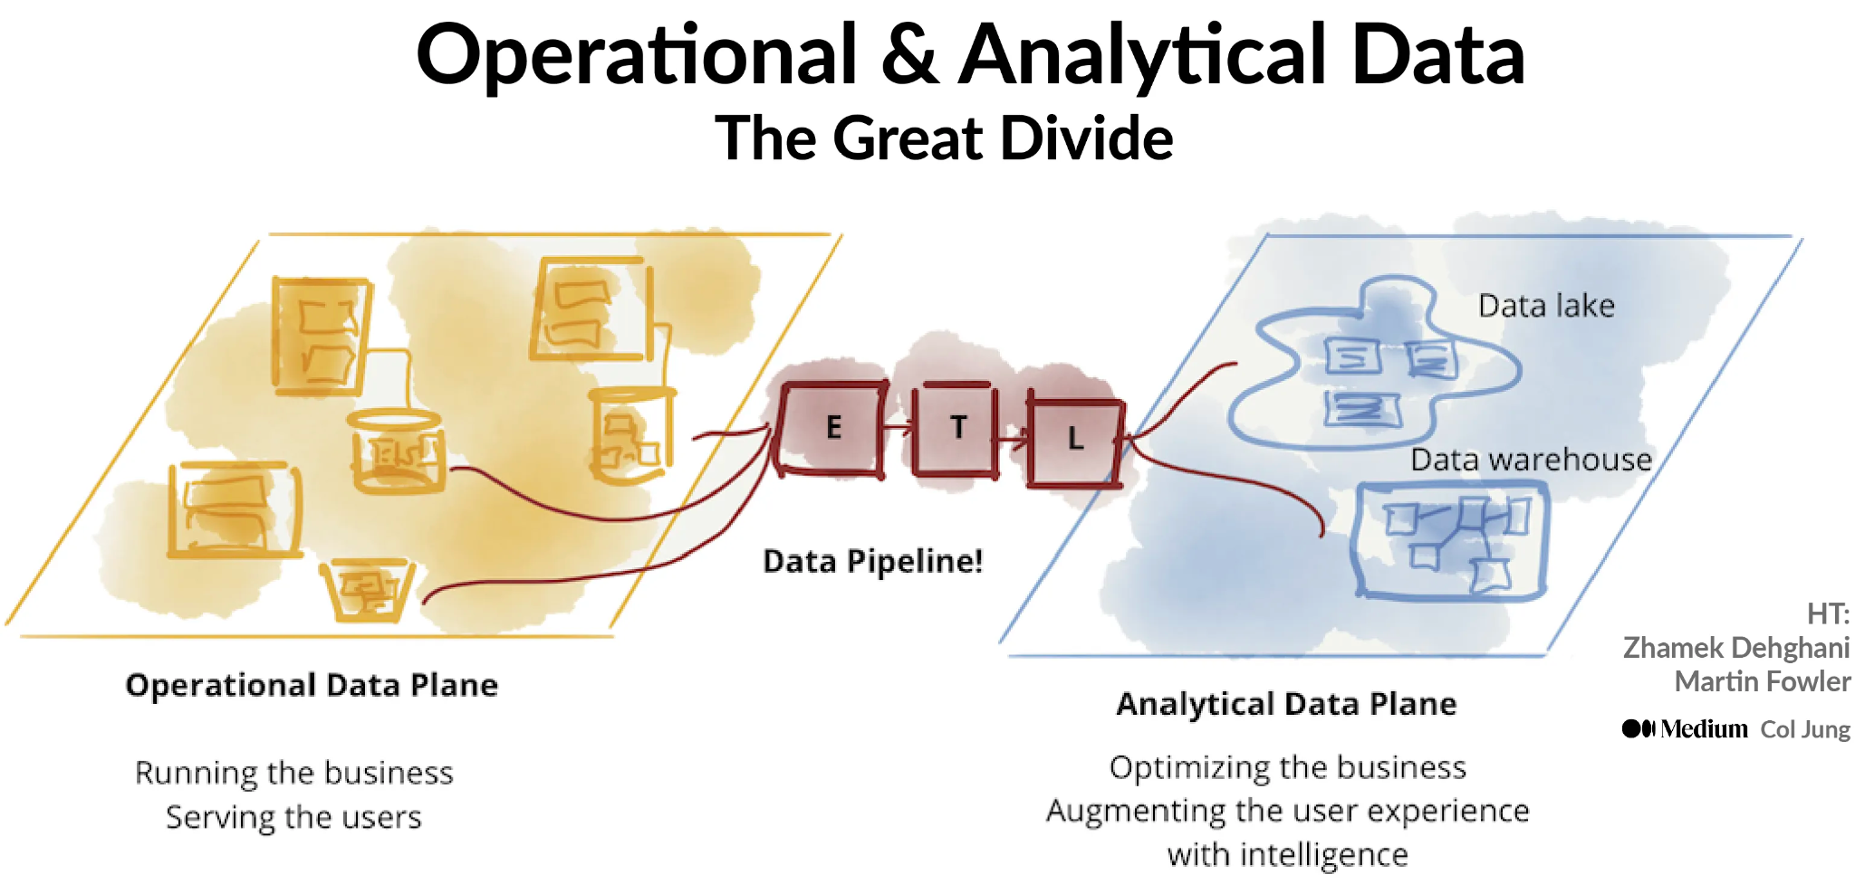
DAta processing Approaches

Slide 8
Business Logic vs Business Intelligence
Business Logic
The set of rules, processes, and algorithms that define how a business operates and makes decisions.
Often implemented within software applications and systems to ensure that they function according to the specific requirements and processes of the business.
It focuses on automating and enforcing the business rules and processes to maintain consistency, accuracy, and efficiency in day-to-day operations.
Business Intelligence
Is the process of collecting, analyzing, and presenting data to gain insights and support decision-making.
It involves the use of technology, tools, and techniques to transform raw data into meaningful and actionable information.
aims to provide stakeholders with a holistic view of the business by
Consolidating data from various sources
applying analytical methods to uncover patterns and trends
Presenting the findings in reports, dashboards, and visualizations.

Slide 9
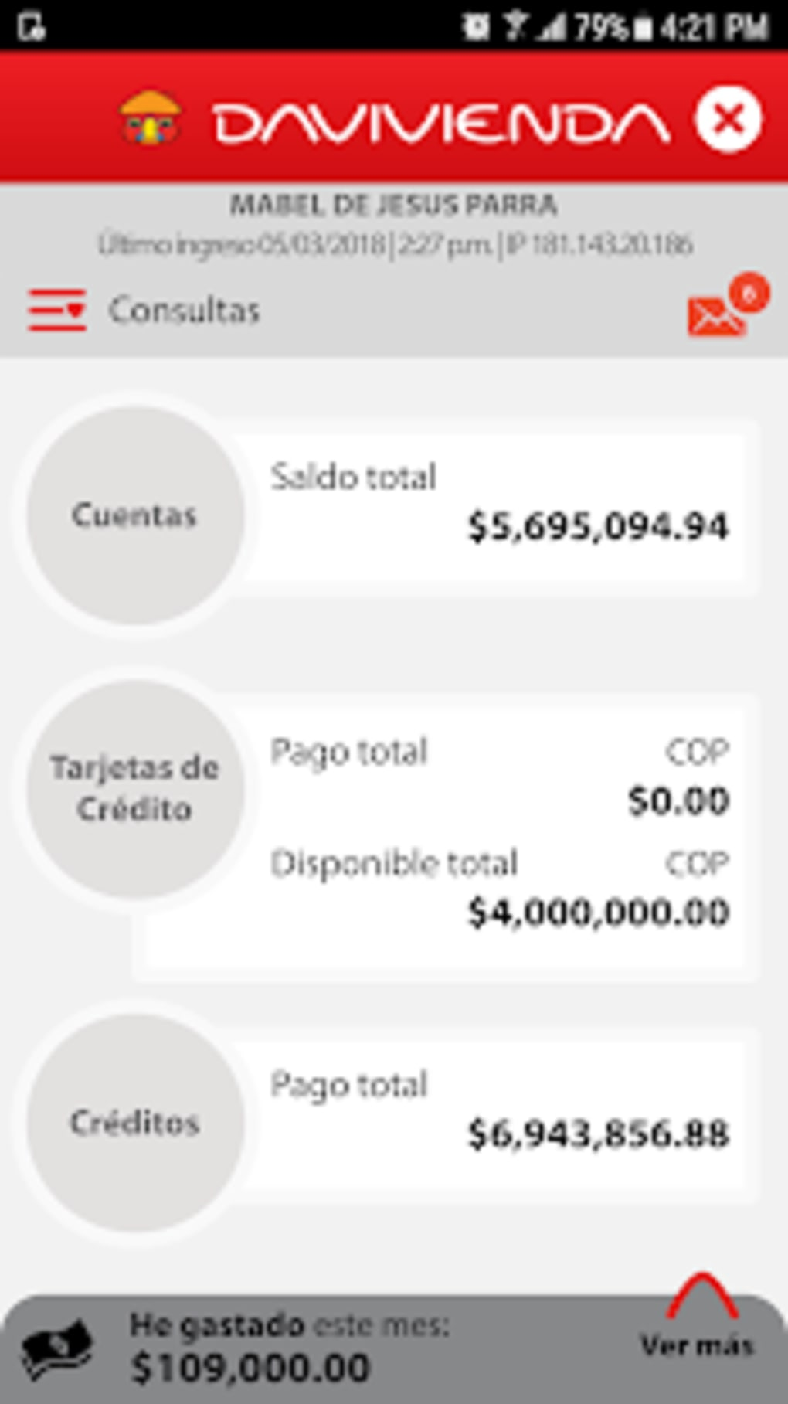
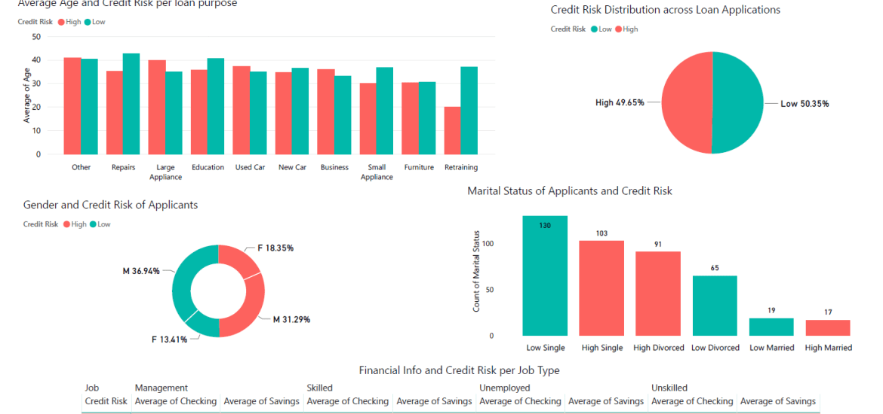
Business Logic vs Business Intelligence
Business Logic
E-commerce Systems
Banking System.
Airline Reservation System
Housing systems
Business Intelligence
Sales Analysis System
Credit Performance
Marketing Analytics Platform.
Supply Chain Analytics System: A system

Slide 10
OLTP & OLAP
OLTP (Online Transaction Processing) and OLAP (Online Analytical Processing) are two distinct approaches to processing and managing data in the field of database management.
OLTP systems handle day-to-day operational transactions of an organization in real time. Supports Business Logic.
OLAP systems are used for analyzing and querying data to gain insights, make informed decisions, and support business intelligence activities. Supports Business Intelligence.
Notes:
OLTP (Online Transaction Processing) and OLAP (Online Analytical Processing) are two distinct approaches to processing and managing data in the field of database management.
OLTP systems handle day-to-day operational transactions of an organization in real time. They are optimized for recording and processing individual transactions, such as inserting, updating, or deleting data in a database.
OLAP systems are used for analyzing and querying data to gain insights, make informed decisions, and support business intelligence activities. It focuses on providing a multidimensional view of data that allows users to perform complex analysis, generate reports, and identify patterns or trends.

Slide 11
OlTP vs OLAP
OLTP
Purpose: OLTP systems focus on recording and processing individual transactions, database CRUD.
Structure: The data is typically organized in a highly normalized structure. It minimizes redundancy and ensures efficient transaction processing. The emphasis is on maintaining data integrity and supporting efficient transactional operations.
Workload: Handle a high volume of small, individual transactions in real time, focusing on maintaining data consistency and integrity.
OLAP
Purpose: OLAP systems provide a multidimensional view of data to support strategic decision-making.
Structure: often use a denormalized or dimensional data model. Data is structured in a way that facilitates complex analysis and reporting. It involves creating multidimensional structures.
Workload Deal with complex queries and aggregations performed on large volumes of historical data. The workload typically consists of read-intensive operations for analysis, reporting, and decision support.

Slide 12
OlTP vs OLAP
OLTP
Performance Requirements: The primary focus of OLTP systems is on transactional processing with low response times. They are optimized for quick and concurrent access to ensure efficient handling of real-time transactions.
User Base: OLTP systems cater to operational staff, such as customer service representatives, who perform daily transactional tasks.
OLAP
Performance Requirements: OLAP systems prioritize query performance and the ability to process complex analytical queries efficiently. The emphasis is on providing fast response times for ad hoc queries and supporting advanced analytics.
User Base: OLAP systems are typically used by business analysts, managers, and decision-makers who require in-depth analysis and reporting capabilities.

Slide 13
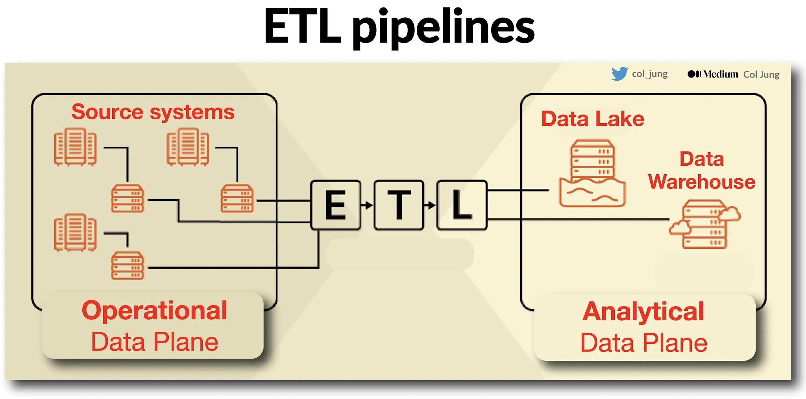
From OlTP To OLAP: data ingestion
Data ingestion is the process of collecting, importing, and loading data from various sources into a storage or processing system, such as a data warehouse, data lake, or database.
It involves acquiring data from different sources, transforming it (if necessary), and making it available for analysis, processing, or storage

Slide 14
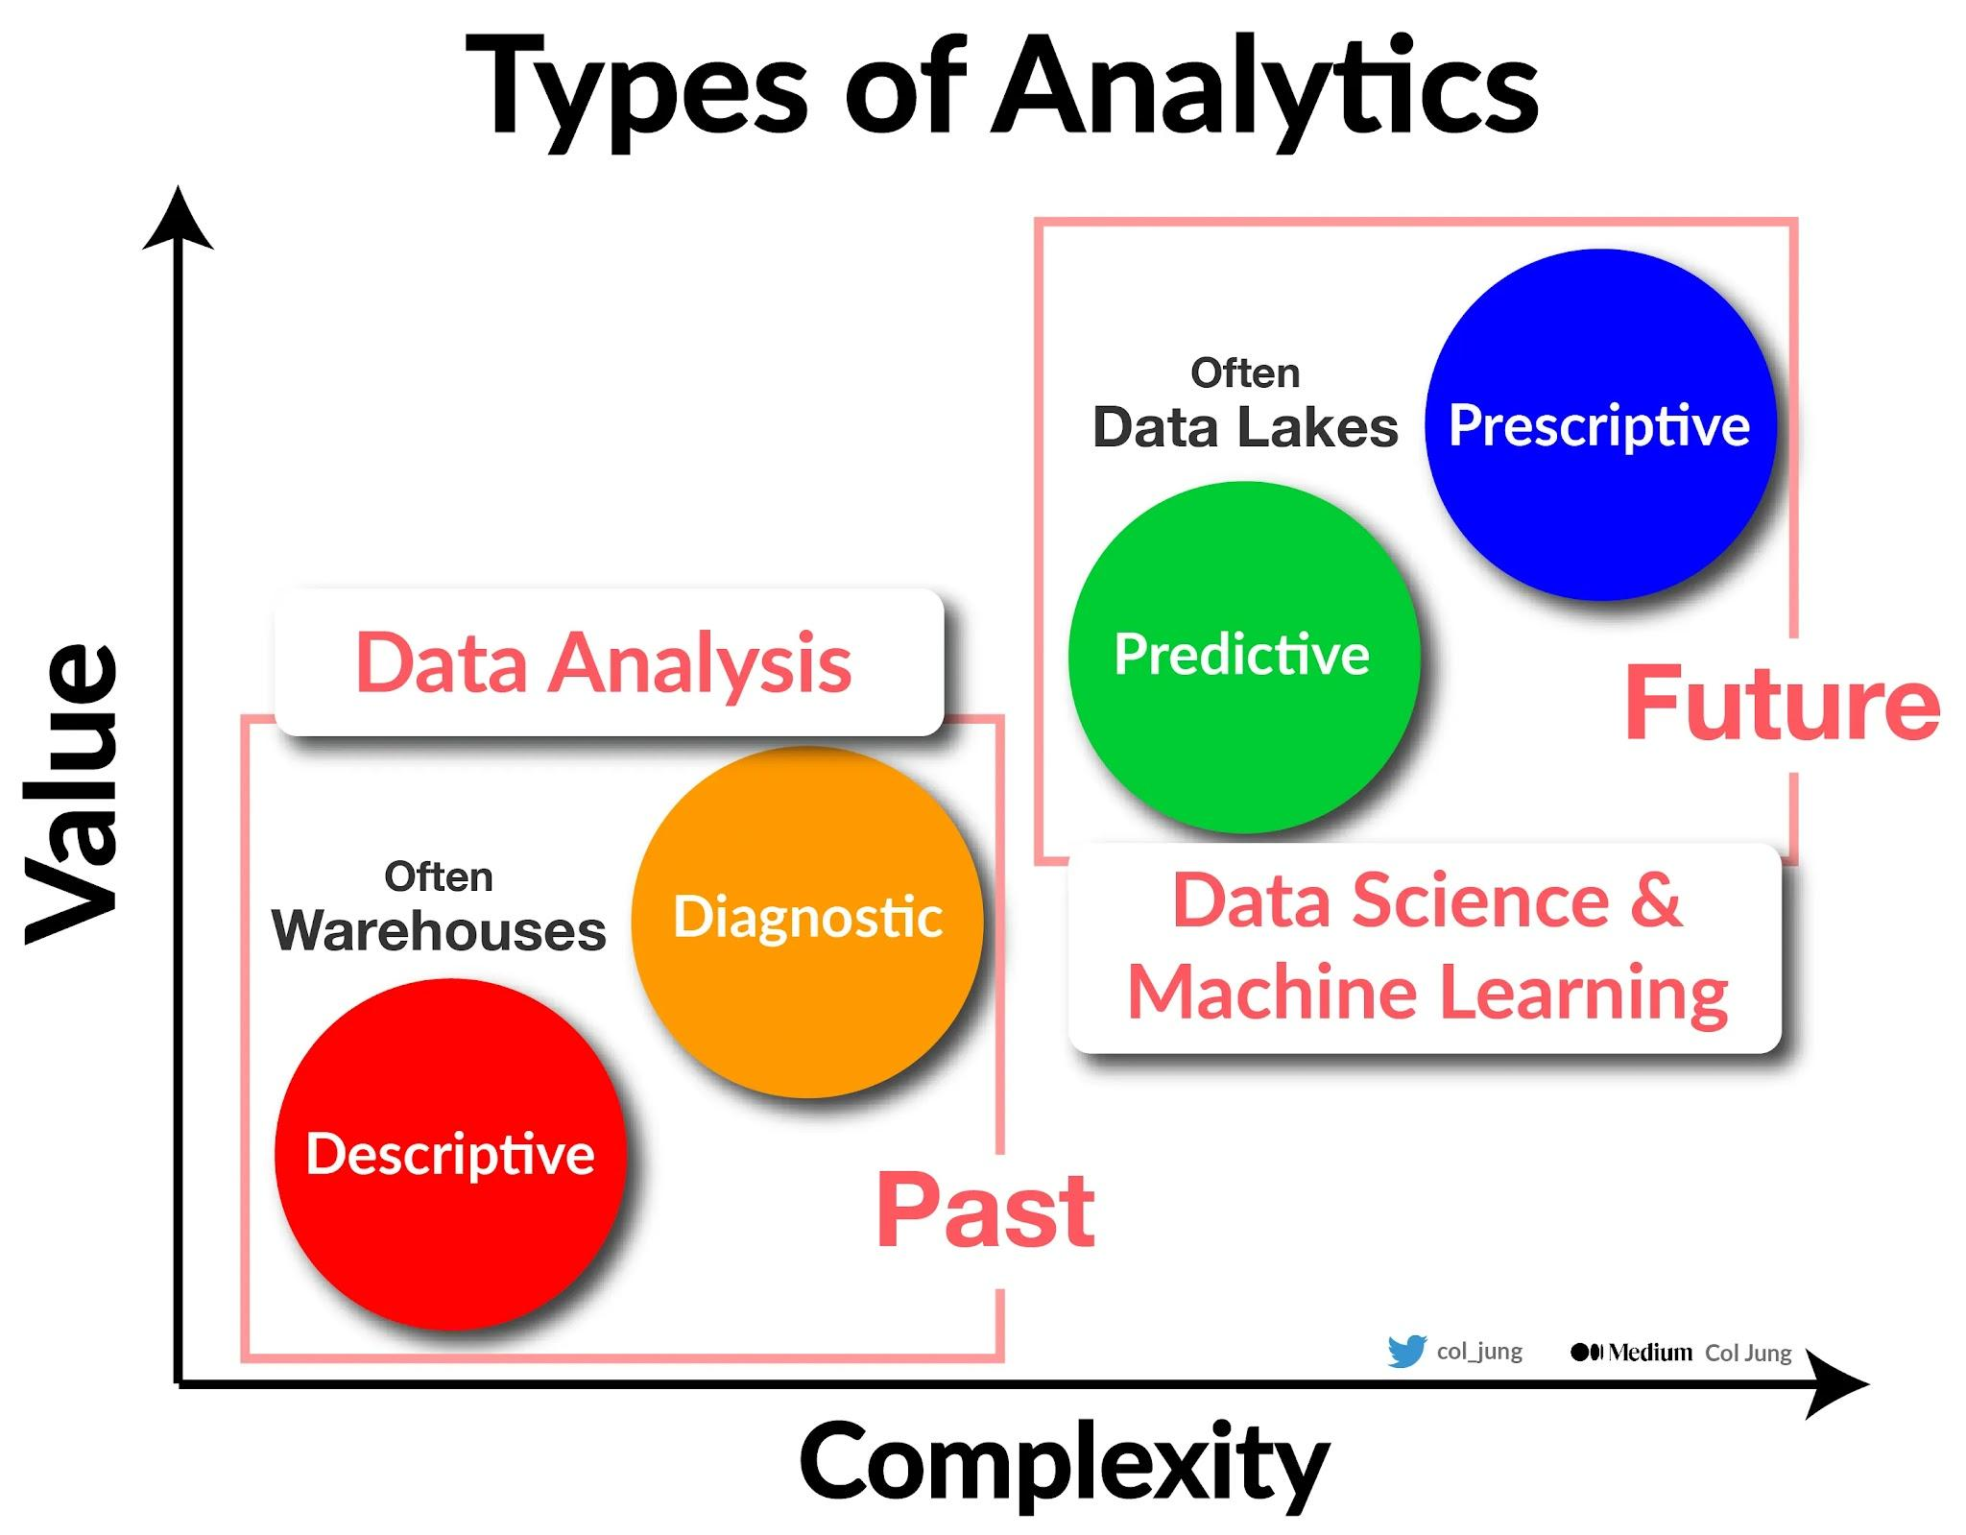
Repositories for BI

Slide 15
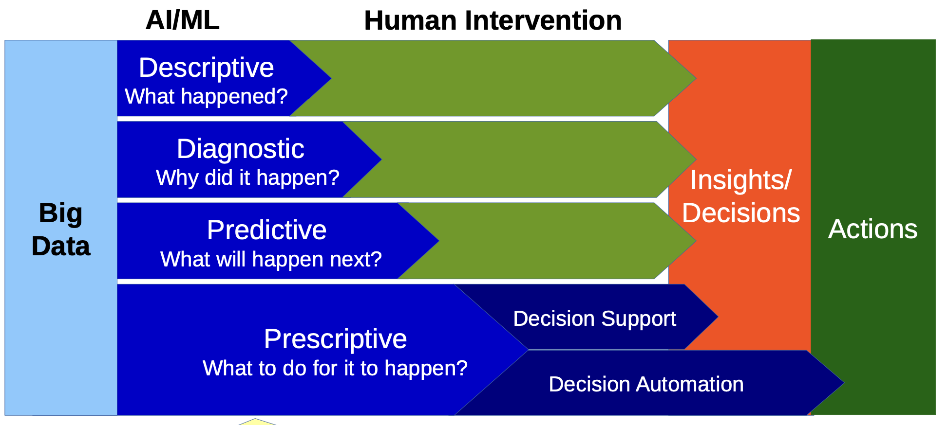
Types of Analytics

Slide 16
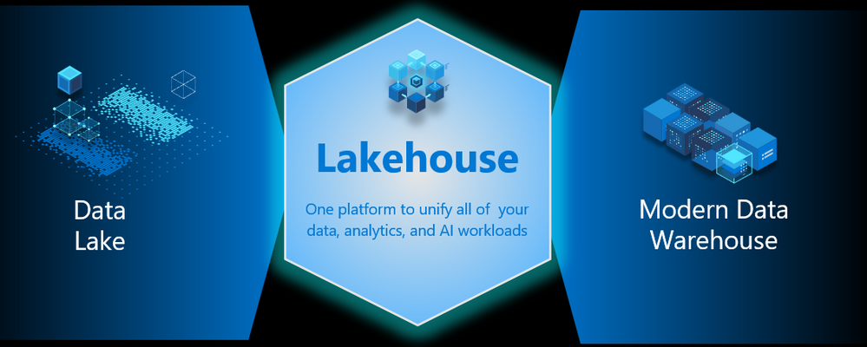

Slide 17
Data wareHouse

Slide 18
DatA Warehouse/ing
A Data Warehouse is a centralized repository of integrated, structured, and historical data that supports business intelligence. It is designed to facilitate efficient data retrieval and analysis for decision-making purposes.
Data Warehousing is the process to operational extract, cleanse, transform, control, and load processes that maintain the data in a data warehouse.

Slide 19
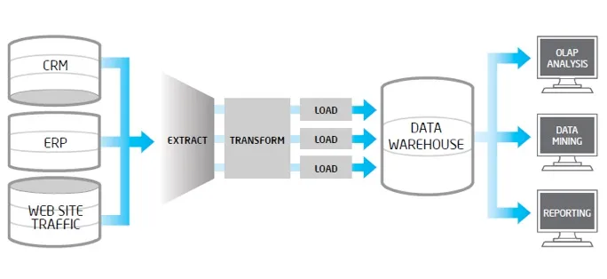
Data WareHousing [Video]
Data WareHouse MGR
ETL Manager
Operational data stores
End-User Access Tools
Image taken from [here]
Notes:
Data warehouse: A subject-oriented, integrated, time variant and nonvolatile collection of data in support of management’s decision making process

Slide 20
DatA in a Data WareHouse
Data in data warehouses is:
Subject-oriented
Integrated
Time-variant
Non-volatile

Slide 21
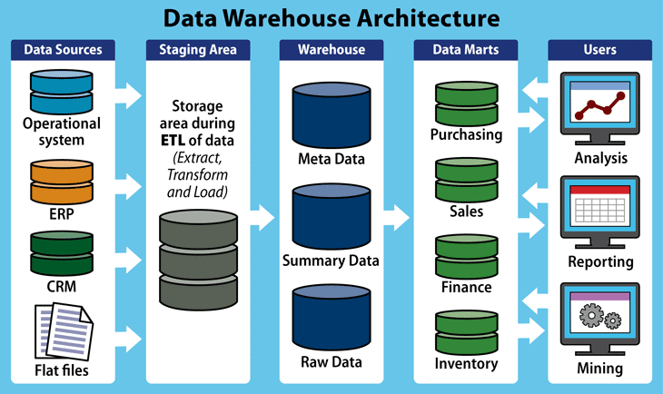
DatA Warehouse Architecture
Notes:
Warehouse manager:
analysis of data to ensure consistency
transformation and merging of source data
- creation of indexes
denormalization
Metadata
definitions used by all the processes in the warehouse
extraction and loading processes
data mart:
database containing a subset of corporate data to support the analytical requirements of a particular business unit

Slide 22

Scenario
X-Mart is having different malls in our city, where daily sales take place for various products. Higher management is facing an issue while decision making due to non availability of integrated data they can’t do study on their data as per their requirement. So they asked us to design a system which can help them quickly in decision making and provide Return on Investment (ROI).

Slide 23
Scenario - Requirements
Need to see daily, weekly, monthly, quarterly profit of each store.
- datekey,day, year,month, yearweek, monthweek, Quarter
Comparison of sales and profit on various time periods.
Comparison of sales in various time bands of the day.
Need to know which product has more demand on which location?
Need to study trend of sales by time period of the day over the week, month, and year?
On what day sales is higher?
On every Sunday of this month, what is sales and what is profit?
What is trend of sales on weekday and weekend?
Need to compare weekly, monthly and yearly sales to know growth and KPI?

Slide 24
Data WareHouse Schema
A schema refers to the logical structure or blueprint that defines how data is organized and stored within a data warehouse.
The scheme determines the relationships between tables, the attributes of each table, and the rules for data integrity and consistency. There are two commonly used types of schemas in data warehousing: star schema, snowflake schema
Both types of schemas are composed by Fact tables and Dimensions

Slide 25
Facts Vs Dimensions
Fact Table
Central table in a data warehouse schema.
Contains quantitative measures or metrics.
Represents the primary focus of analysis.
Associated with dimension tables through foreign keys.
Contains aggregated values for efficient querying.
Granularity determines the level of detail stored.
Measures include sales revenue, quantity sold, etc.
Dimensions:
Supporting table in a data warehouse schema.
Provides descriptive attributes to add context.
Defines characteristics of the data.
Often has hierarchies for drilling down or rolling up.
Linked to the fact table through foreign keys.
Examples: time, geography, product, customer.

Slide 26
The relational model - Concepts
Relational database. A collection of normalized relations with different names.
Normalization: Table normalization is a process in database design that aims to eliminate redundancy and improve data integrity by organizing data into separate tables.
Primary Key: identifier, there are no duplicate tuples in a table.
Foreign Key: It is a column or a set of columns in one table that refers to the primary key of another table. The foreign key creates a link between the two tables, enabling data integrity and enforcing referential integrity constraints.
Notes:
Relation:
Las relaciones contienen información de los objetos representados en la base de datos.
Una relación es una tabla bidimensional cuyas filas corresponden a registros individuales y las columnas son los atributos.
Attributes.
Los atributos pueden aparecer en cualquier orden en la relación.
Cada columna contiene valores de un solo atributo.
Domains
El concepto de dominio es importante porque permite al ingeniero definir en un solo lugar el significado y fuente de los valores que los atributos pueden tomar.
Esto permite que se eviten los errores cuando se quieran hacer consultas u operaciones sobre la base de datos. Similar a la validación estática de tipos en un lenguaje de programación. PERO, tiene en cuenta la semántica (significado del campo, así se evita comparar dos campos que son del mismo tipo pero que tienen significados distintos)
En consecuencia, los dominios proveen más información (semántica) que los tipos de datos.
Tuple
Las tuplas pueden aparecer en cualquier orden sin que eso afecte la relación. No obstante, cada tupla es única en la tabla.
Database
Las relaciones en la base de datos deben estar estructuradas “apropiadamente” o cumpler ciertas propiedades (formas normales). El proceso para normalizar una base de datos sale de los temas de este curso.

Slide 27
Modeling a Data wareHouses
Star
Structure: data is organized around a central fact table, which contains the measures or key performance indicators (KPIs) of interest. The fact table is surrounded by dimension tables, each representing a specific attribute or perspective of the data, such as time, product, customer, or location.
Relationships: The fact table is connected to dimension tables through foreign keys, establishing one-to-many relationships. The dimension tables provide descriptive attributes that provide context to the measures in the fact table.
Snowflake
Structure: extends the star schema by further normalizing the dimension tables. This means that dimension tables are split into multiple tables, reducing redundancy by storing attribute hierarchies and relationships in separate tables.
Relationships and Normalization: The relationships between tables in the snowflake schema are more granular, with additional join paths. Dimension tables are typically normalized, resulting in a more complex structure compared to the star schema.

Slide 28
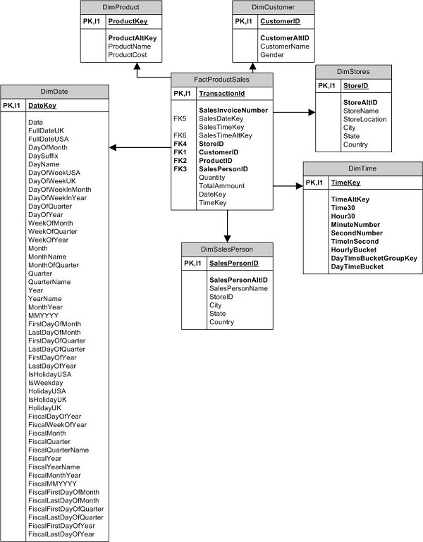
Data WareHouse Schema

Slide 29
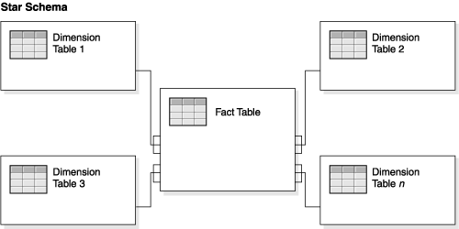
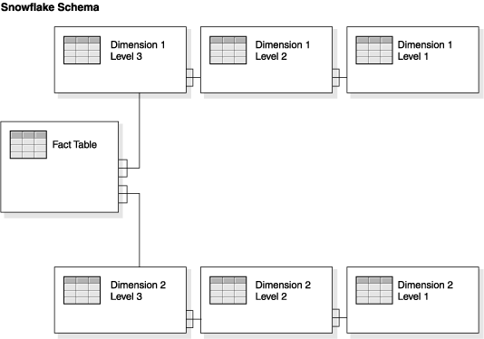
Image taken from [here]

Slide 30
Queries, examples
"What is the customer lifetime value?" This query calculates the total revenue generated by each customer over their lifetime. It helps identify the most valuable customers, enabling targeted marketing strategies or personalized customer experiences.
"How are sales distributed by region and year?" This query provides an overview of sales distribution across different regions and years. It helps identify regional performance trends and allows for a comparison of sales performance between different time periods.
"How do products perform in terms of sales and average price?" This query compares products based on their sales performance and average price. It helps identify products that generate high sales revenue or products with high demand at specific price points.

Slide 31
Tools (ejercicio)

Slide 32
Online analytical processing (OLAP)

Slide 33
Olap Cube
An OLAP cube, is a data structure to facilitate fast and efficient multidimensional analysis of data. It provides a multidimensional view of data that allows users to analyze and explore data from different dimensions and levels of granularity.
OLAP cubes organize data based on Dimensions and Measures,
Dimensions represent the different attributes or characteristics of the data, e.g., time, geography, product, or customer.
Measures represent the metrics that are being analyzed. Measures are associated with the intersection points of dimensions in the cube.
A relational database table is structured like a spreadsheet, storing individual records in a two-dimensional, row-by-column format. Each data “fact” in the database sits at the intersection of two dimensions–a row and a column

Slide 34
Case study - DreamHouse
DreamHouse= {Branch, Staff, PropertyForRent, Client, PrivateOwner, Viewing}
Branch (branchNo, street, city, postcode)
Staff (staffNo, fName, lName, position, sex, DOB, salary, branchNo)
PropertyForRent (propertyNo, street, city, postcode, type, rooms, rent, ownerNo, staffNo, branchNo)
Client (clientNo, fName, lName, telNo, prefType, maxRent, eMail)
PrivateOwner (ownerNo, fName, lName, address, telNo, eMail, password)
Viewing (clientNo, propertyNo, viewDate, comment)
Registration (clientNo, branchNo, staffNo, dateJoined)
Link to the spreadsheet of the example [open]

Slide 35
DatA Warehousing queries
DWH systems can answer ad-hoc queries ad store historical data, which is necessary for analyzing trends.
What is the total revenue for Scotland in the third quarter of 2008?
What are the three most popular areas in each city for the renting of property in 2008 and how do these results compare with the results for the previous two years?
What is the relationship between the total annual revenue generated by each branch office and the total number of sales staff assigned to each branch office?

Slide 36
Multidimensional data, Example
Go to [Miro board]

Slide 37
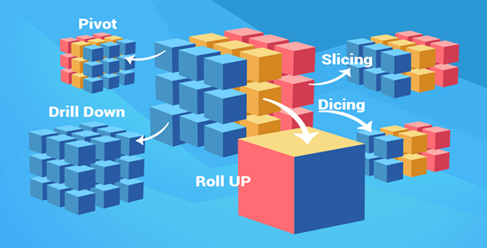
Multidimensional operations, example
Roll-up. Performs aggregations by moving up the dimensional hierarchy
Drill-down. Reverse to roll-up, reveals the detailed data confirming the aggregated data.
Slice and dice. Refers to the ability to look at data from different viewpoints, performs a selection on one dimension on the data
Pivot. Rotates the data to provide an alternative view of the same data.

Slide 38
Categories of OLAP Servers
OLAP Servers are categorized regarding the architecture used to store and process multidimensional data.
Multidimensional OLAP
Relational OLAP
Hybrid OLAP
Desktop OLAP

Slide 39
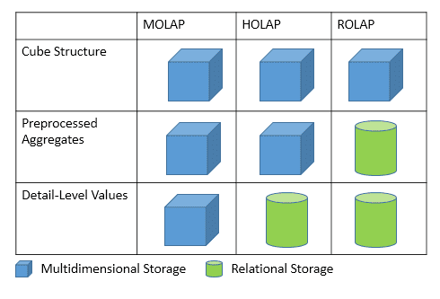
Categories of OLAP Servers
OLAP Servers are categorized regarding the architecture used to store and process multidimensional data.
Multidimensional OLAP works directly with a multidimensional OLAP cube
Relational OLAP is multidimensional data analysis that operates directly on data on relational tables, without first reorganizing the data into a cube.
Hybrid OLAP attempts to create the optimal division of labor between relational and multidimensional databases within a single OLAP architecture.

